Slide 1
Working with Strings and StringBuffer
The Immutable String

Slide 2

Overview
String immutability
Concatenating Strings (+, +=)
Important String methods
Changing String methods
StringBuffer type and mehods

Slide 3
String Concatenation

Slide 4
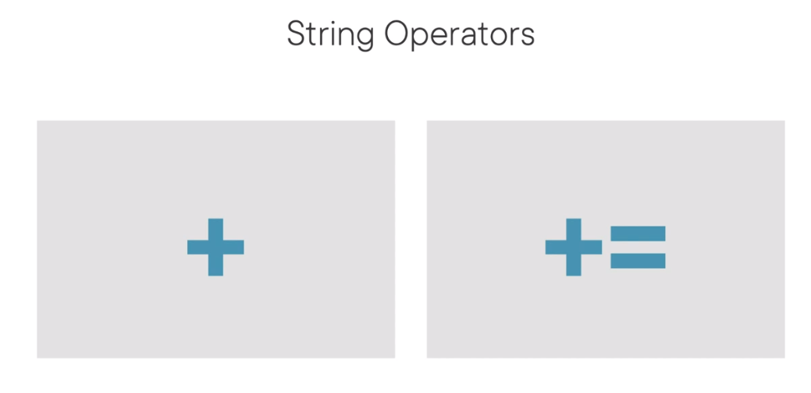

Slide 5
String Methods, Part 1

Slide 6
String Methods, Part 2

Slide 7
StringBuilder, Part 1

Slide 8
StringBuilder, Part 2

Slide 9

Assisted Practice
append( )
indexOf( ) charAt( ) replace( ) deleteCharAt( )
delete( ) substring( )

Slide 10
The java.lang.String is immutable
Strings can be concatenated using + and +=
The String type provides dozens of convenience methods
charAt(), length(), indexOf(), substring(), etc.
String methods can be chained together
StringBuilder is similar to String, but mutable
Summary

